Slide 1
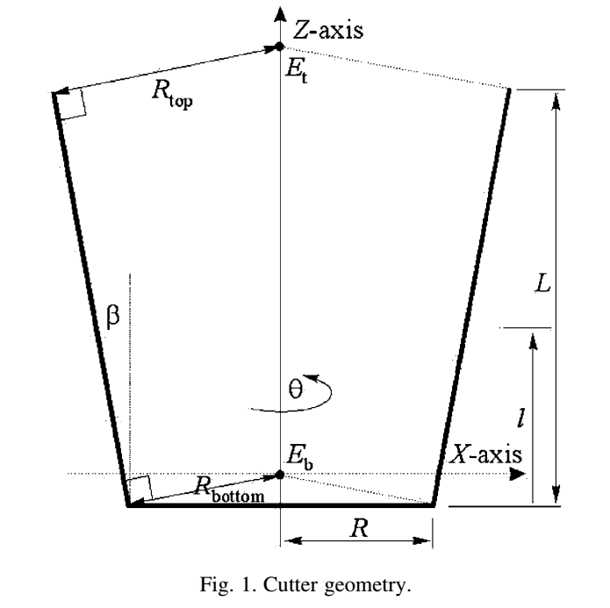
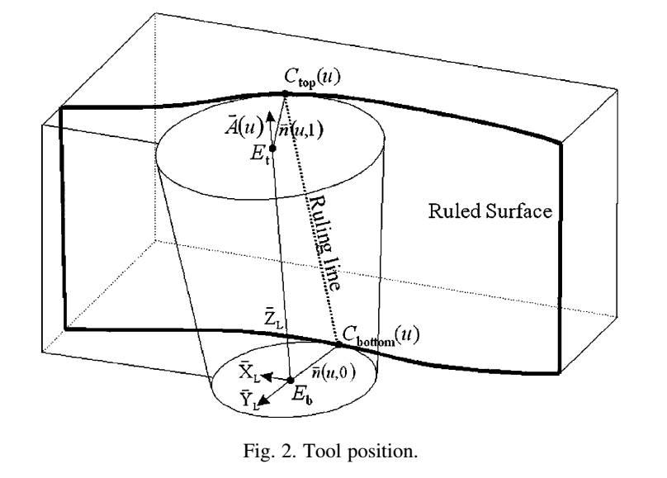




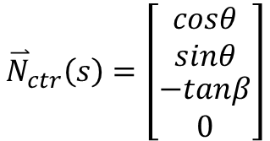



A machining potential field approach to tool path generation for multi-axis sculptured surface machining
John C.J. Chiou
Tool surface normal vector:
$${\overset{⃑}{N}}_{ctr}\left(s\right)=\left[\begin{matrix}\begin{matrix}cosθ \\ sinθ\end{matrix} \\ \begin{matrix}−tanβ \\ 0\end{matrix}\end{matrix}\right]$$
$$\overset{⃑}{N}\left(u,s\right)=\left[\begin{matrix}\begin{matrix}{\overset{⃑}{X}}_{L} & {\overset{⃑}{Y}}_{L}\end{matrix} & \begin{matrix}{\overset{⃑}{Z}}_{L} & 0\end{matrix}\end{matrix}\right]{\overset{⃑}{N}}_{ctr}(s)$$
(8)
The velocity of a point on the cutter surface:
$$\overset{⃑}{V}\left(u,s\right)=\frac{∂\left[\begin{matrix}\begin{matrix}{\overset{⃑}{X}}_{L} & {\overset{⃑}{Y}}_{L}\end{matrix} & \begin{matrix}{\overset{⃑}{Z}}_{L} & E_{b}\end{matrix}\end{matrix}\right]}{∂u}M_{ctr}(s)$$
(9)
$$M_{ctr}\left(s\right)=\left[\begin{matrix}\begin{matrix}\left(R+ltanβ\right)cosθ \\ \left(R+ltanβ\right)sinθ\end{matrix} \\ \begin{matrix}−Rtanβ+l \\ 1\end{matrix}\end{matrix}\right]$$
$$=\frac{∂E_{b}}{∂u}+Ω×\left(\left[\begin{matrix}\begin{matrix}{\overset{⃑}{X}}_{L} & {\overset{⃑}{Y}}_{L}\end{matrix} & \begin{matrix}{\overset{⃑}{Z}}_{L} & 0\end{matrix}\end{matrix}\right]\right)M_{ctr}(s))$$
Tangency function F:
$$F=\overset{⃑}{V}\left(u,s^{∗}\right)∙\overset{⃑}{N}\left(u,s^{∗}\right)=0$$
(12)
$${\left[\begin{matrix}\begin{matrix}V_{x} & V_{y}\end{matrix} & \begin{matrix}V_{z} & 0\end{matrix}\end{matrix}\right]}^{T}={\left[{\left[\begin{matrix}\begin{matrix}{\overset{⃑}{X}}_{L} & {\overset{⃑}{Y}}_{L}\end{matrix} & \begin{matrix}{\overset{⃑}{Z}}_{L} & 0\end{matrix}\end{matrix}\right]}^{−1}{\dot{E}}_{b}\right]}^{T}$$
Where:
$${\left[\begin{matrix}\begin{matrix}Ω_{x} & Ω_{y}\end{matrix} & \begin{matrix}Ω_{z} & 0\end{matrix}\end{matrix}\right]}^{T}={\left[{\left[\begin{matrix}\begin{matrix}{\overset{⃑}{X}}_{L} & {\overset{⃑}{Y}}_{L}\end{matrix} & \begin{matrix}{\overset{⃑}{Z}}_{L} & 0\end{matrix}\end{matrix}\right]}^{−1}Ω\right]}^{T}$$

Slide 2
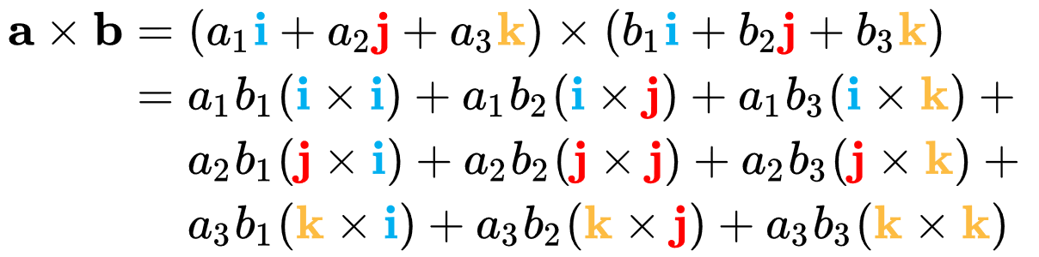
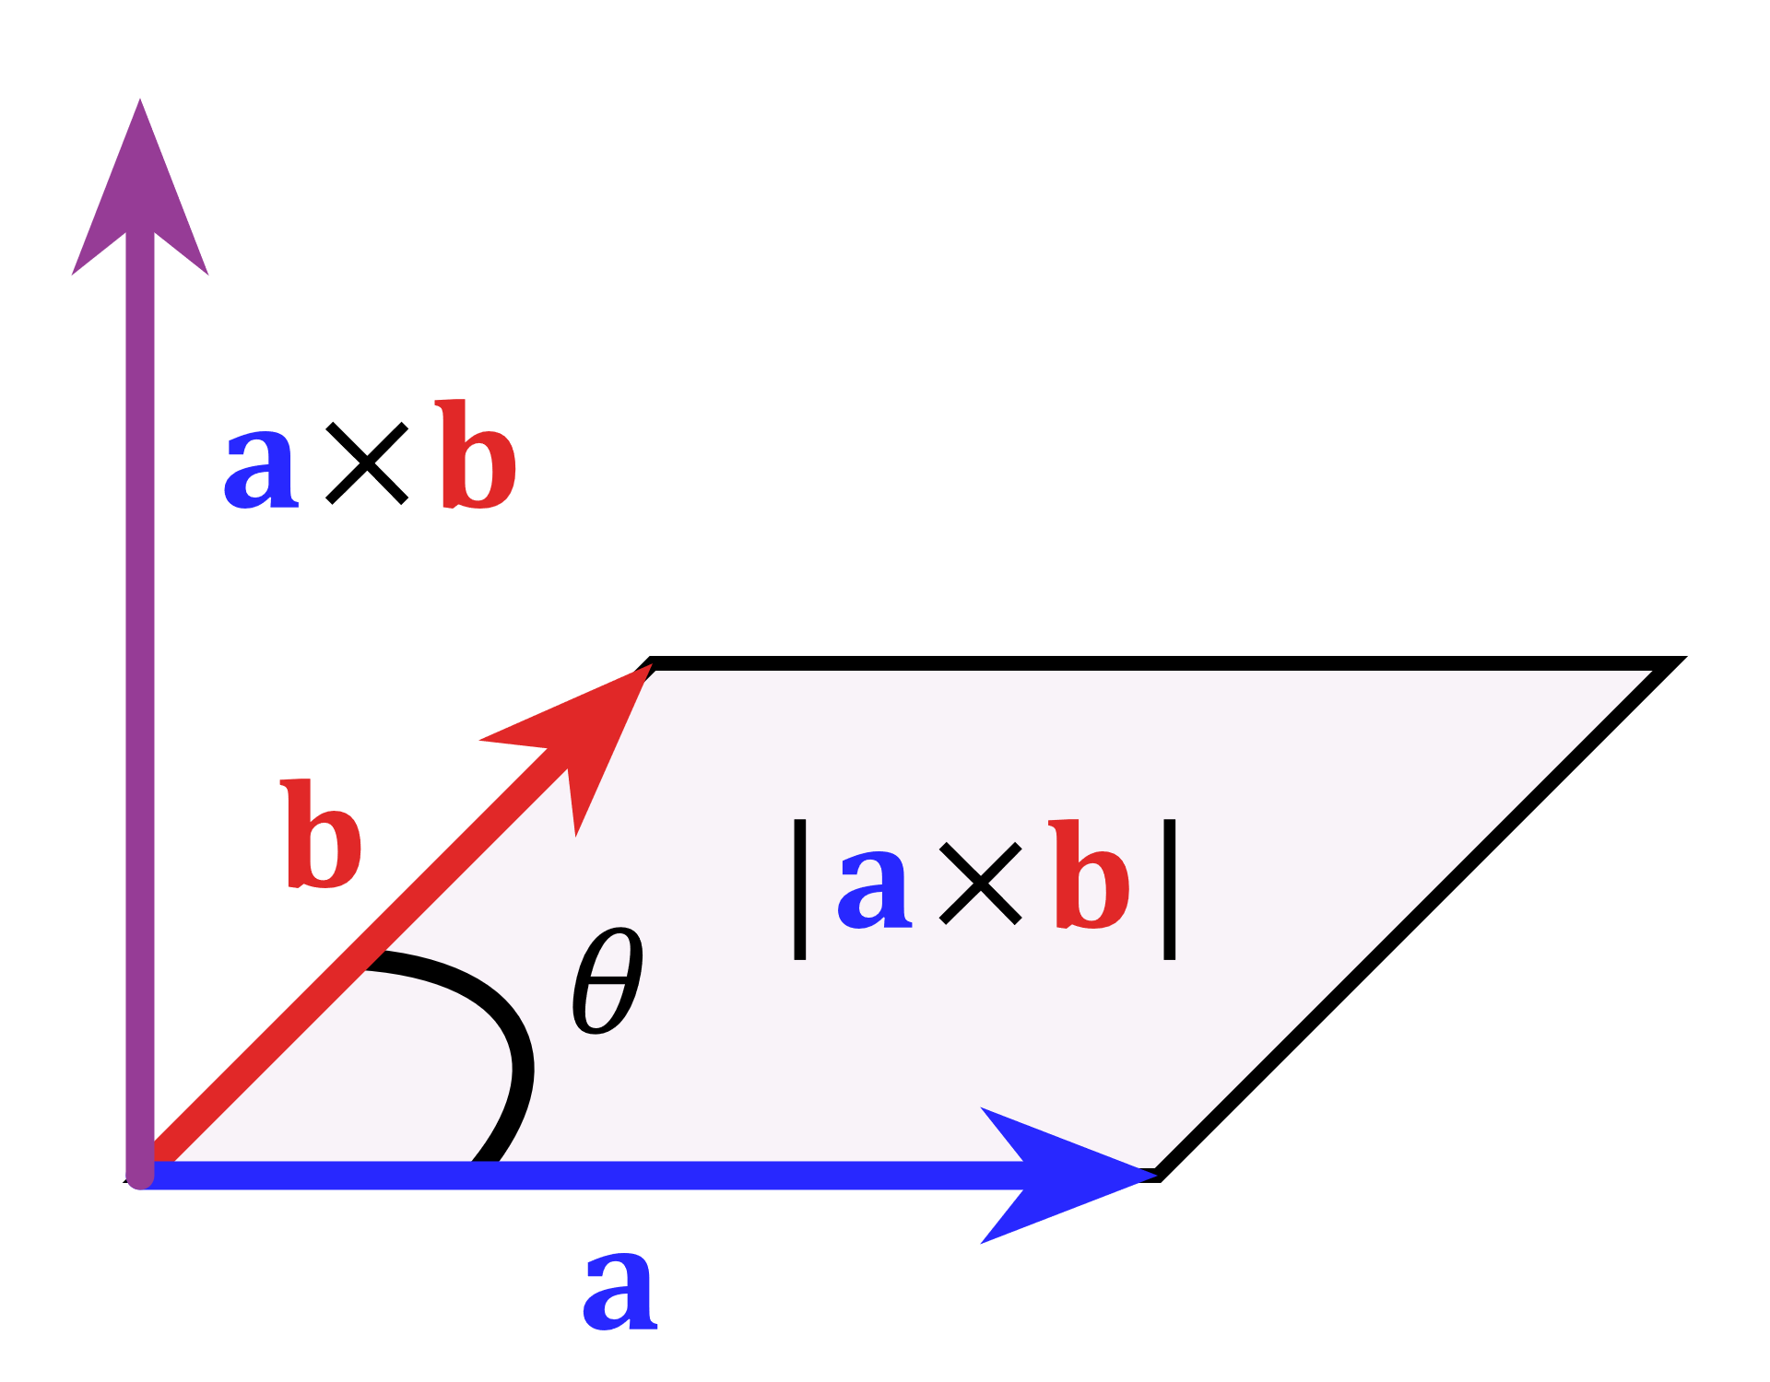
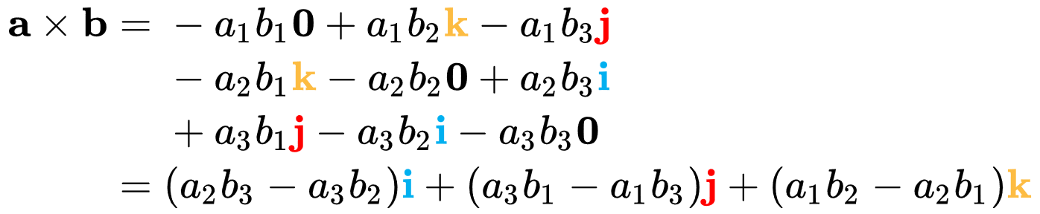



Something about cross product (from wiki):
The cross product is anticommutative:
The area of a parallelogram as the magnitude of a cross product
The scalar triple product is unchanged under a circular shift of its three operands (a, b, c):
From the geometrical definition, the cross product is invariant under proper rotations about the axis defined by a × b. In formulae:
where $ℝ$is a rotation matrix with $\det\left(ℝ\right)=1$

Slide 3
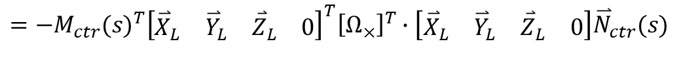
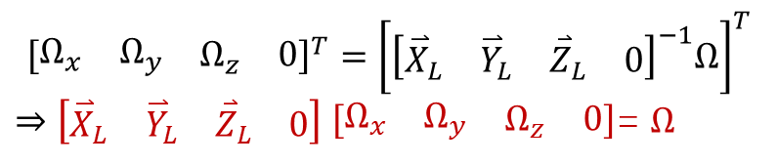

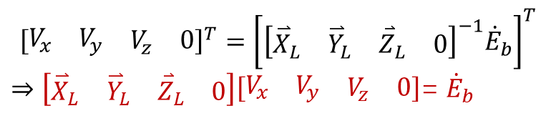





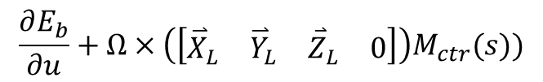
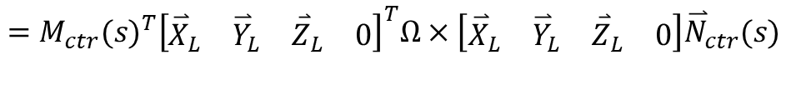
Tangency function F:
I think the more appropriate format is:
$$F=\overset{⃑}{V}\left(u,s^{∗}\right)∙\overset{⃑}{N}\left(u,s^{∗}\right)=0$$
$F={\overset{⃑}{V}\left(u,s^{∗}\right)}^{T}∙\overset{⃑}{N}\left(u,s^{∗}\right)$=0
$$\frac{∂E_{b}}{∂u}+Ω×\left(\left[\begin{matrix}\begin{matrix}{\overset{⃑}{X}}_{L} & {\overset{⃑}{Y}}_{L}\end{matrix} & \begin{matrix}{\overset{⃑}{Z}}_{L} & 0\end{matrix}\end{matrix}\right]\right)M_{ctr}(s))$$
$$\left[\begin{matrix}\begin{matrix}{\overset{⃑}{X}}_{L} & {\overset{⃑}{Y}}_{L}\end{matrix} & \begin{matrix}{\overset{⃑}{Z}}_{L} & 0\end{matrix}\end{matrix}\right]{\overset{⃑}{N}}_{ctr}(s)$$
Where $\frac{∂E_{b}}{∂u}={\dot{E}}_{b}$
${{\dot{E}}_{b}}^{T}∙$ $\left[\begin{matrix}\begin{matrix}{\overset{⃑}{X}}_{L} & {\overset{⃑}{Y}}_{L}\end{matrix} & \begin{matrix}{\overset{⃑}{Z}}_{L} & 0\end{matrix}\end{matrix}\right]{\overset{⃑}{N}}_{ctr}\left(s\right)={−M_{ctr}(s)}^{T}{\left(Ω×\left(\left[\begin{matrix}\begin{matrix}{\overset{⃑}{X}}_{L} & {\overset{⃑}{Y}}_{L}\end{matrix} & \begin{matrix}{\overset{⃑}{Z}}_{L} & 0\end{matrix}\end{matrix}\right]\right)\right)}^{T}∙\left[\begin{matrix}\begin{matrix}{\overset{⃑}{X}}_{L} & {\overset{⃑}{Y}}_{L}\end{matrix} & \begin{matrix}{\overset{⃑}{Z}}_{L} & 0\end{matrix}\end{matrix}\right]{\overset{⃑}{N}}_{ctr}(s)$
$$=−{M_{ctr}(s)}^{T}{\left[\begin{matrix}\begin{matrix}{\overset{⃑}{X}}_{L} & {\overset{⃑}{Y}}_{L}\end{matrix} & \begin{matrix}{\overset{⃑}{Z}}_{L} & 0\end{matrix}\end{matrix}\right]}^{T}{\left[Ω_{×}\right]}^{T}∙\left[\begin{matrix}\begin{matrix}{\overset{⃑}{X}}_{L} & {\overset{⃑}{Y}}_{L}\end{matrix} & \begin{matrix}{\overset{⃑}{Z}}_{L} & 0\end{matrix}\end{matrix}\right]{\overset{⃑}{N}}_{ctr}(s)$$
$=$ ${M_{ctr}(s)}^{T}{\left[\begin{matrix}\begin{matrix}{\overset{⃑}{X}}_{L} & {\overset{⃑}{Y}}_{L}\end{matrix} & \begin{matrix}{\overset{⃑}{Z}}_{L} & 0\end{matrix}\end{matrix}\right]}^{T}Ω×\left[\begin{matrix}\begin{matrix}{\overset{⃑}{X}}_{L} & {\overset{⃑}{Y}}_{L}\end{matrix} & \begin{matrix}{\overset{⃑}{Z}}_{L} & 0\end{matrix}\end{matrix}\right]{\overset{⃑}{N}}_{ctr}(s)$
Cross product matrix:
$$Ω×=\left[Ω_{×}\right]=\left[\begin{matrix}0 & −Ω_{3} & Ω_{2} \\ Ω_{3} & 0 & {−Ω}_{1} \\ −Ω_{2} & Ω_{1} & 0\end{matrix}\right]$$
$${\left[\begin{matrix}\begin{matrix}V_{x} & V_{y}\end{matrix} & \begin{matrix}V_{z} & 0\end{matrix}\end{matrix}\right]}^{T}={\left[{\left[\begin{matrix}\begin{matrix}{\overset{⃑}{X}}_{L} & {\overset{⃑}{Y}}_{L}\end{matrix} & \begin{matrix}{\overset{⃑}{Z}}_{L} & 0\end{matrix}\end{matrix}\right]}^{−1}{\dot{E}}_{b}\right]}^{T}$$
$⇒\left[\begin{matrix}\begin{matrix}{\overset{⃑}{X}}_{L} & {\overset{⃑}{Y}}_{L}\end{matrix} & \begin{matrix}{\overset{⃑}{Z}}_{L} & 0\end{matrix}\end{matrix}\right]\left[\begin{matrix}\begin{matrix}V_{x} & V_{y}\end{matrix} & \begin{matrix}V_{z} & 0\end{matrix}\end{matrix}\right]$= ${\dot{E}}_{b}$
$${\left[Ω_{×}\right]}^{T}=−\left[Ω_{×}\right]$$
$${\left[\begin{matrix}\begin{matrix}Ω_{x} & Ω_{y}\end{matrix} & \begin{matrix}Ω_{z} & 0\end{matrix}\end{matrix}\right]}^{T}={\left[{\left[\begin{matrix}\begin{matrix}{\overset{⃑}{X}}_{L} & {\overset{⃑}{Y}}_{L}\end{matrix} & \begin{matrix}{\overset{⃑}{Z}}_{L} & 0\end{matrix}\end{matrix}\right]}^{−1}Ω\right]}^{T}$$
$⇒\left[\begin{matrix}\begin{matrix}{\overset{⃑}{X}}_{L} & {\overset{⃑}{Y}}_{L}\end{matrix} & \begin{matrix}{\overset{⃑}{Z}}_{L} & 0\end{matrix}\end{matrix}\right]$ $\left[\begin{matrix}\begin{matrix}Ω_{x} & Ω_{y}\end{matrix} & \begin{matrix}Ω_{z} & 0\end{matrix}\end{matrix}\right]$= $Ω$

Slide 4


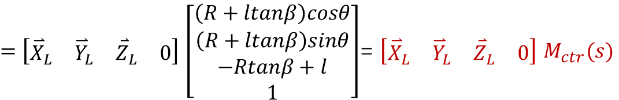
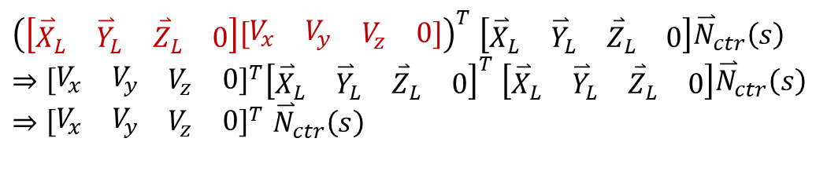
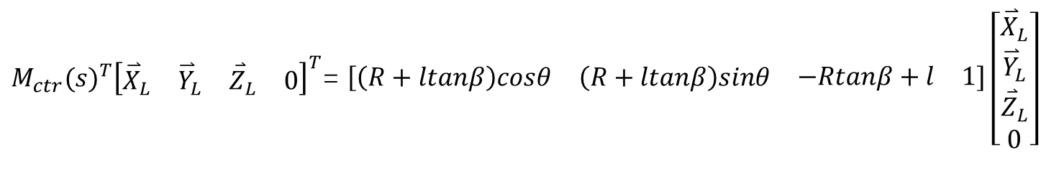
${{\dot{E}}_{b}}^{T}∙$ $\left[\begin{matrix}\begin{matrix}{\overset{⃑}{X}}_{L} & {\overset{⃑}{Y}}_{L}\end{matrix} & \begin{matrix}{\overset{⃑}{Z}}_{L} & 0\end{matrix}\end{matrix}\right]{\overset{⃑}{N}}_{ctr}\left(s\right)=$
$${M_{ctr}(s)}^{T}{\left[\begin{matrix}\begin{matrix}{\overset{⃑}{X}}_{L} & {\overset{⃑}{Y}}_{L}\end{matrix} & \begin{matrix}{\overset{⃑}{Z}}_{L} & 0\end{matrix}\end{matrix}\right]}^{T}Ω×\left[\begin{matrix}\begin{matrix}{\overset{⃑}{X}}_{L} & {\overset{⃑}{Y}}_{L}\end{matrix} & \begin{matrix}{\overset{⃑}{Z}}_{L} & 0\end{matrix}\end{matrix}\right]{\overset{⃑}{N}}_{ctr}(s)$$
${\left(\left[\begin{matrix}\begin{matrix}{\overset{⃑}{X}}_{L} & {\overset{⃑}{Y}}_{L}\end{matrix} & \begin{matrix}{\overset{⃑}{Z}}_{L} & 0\end{matrix}\end{matrix}\right]\left[\begin{matrix}\begin{matrix}V_{x} & V_{y}\end{matrix} & \begin{matrix}V_{z} & 0\end{matrix}\end{matrix}\right]\right)}^{T}$ $\left[\begin{matrix}\begin{matrix}{\overset{⃑}{X}}_{L} & {\overset{⃑}{Y}}_{L}\end{matrix} & \begin{matrix}{\overset{⃑}{Z}}_{L} & 0\end{matrix}\end{matrix}\right]{\overset{⃑}{N}}_{ctr}\left(s\right)$
$⇒{\left[\begin{matrix}\begin{matrix}V_{x} & V_{y}\end{matrix} & \begin{matrix}V_{z} & 0\end{matrix}\end{matrix}\right]}^{T}{\left[\begin{matrix}\begin{matrix}{\overset{⃑}{X}}_{L} & {\overset{⃑}{Y}}_{L}\end{matrix} & \begin{matrix}{\overset{⃑}{Z}}_{L} & 0\end{matrix}\end{matrix}\right]}^{T}$ $\left[\begin{matrix}\begin{matrix}{\overset{⃑}{X}}_{L} & {\overset{⃑}{Y}}_{L}\end{matrix} & \begin{matrix}{\overset{⃑}{Z}}_{L} & 0\end{matrix}\end{matrix}\right]{\overset{⃑}{N}}_{ctr}\left(s\right)$
$⇒{\left[\begin{matrix}\begin{matrix}V_{x} & V_{y}\end{matrix} & \begin{matrix}V_{z} & 0\end{matrix}\end{matrix}\right]}^{T}$ ${\overset{⃑}{N}}_{ctr}\left(s\right)$
${M_{ctr}(s)}^{T}{\left[\begin{matrix}\begin{matrix}{\overset{⃑}{X}}_{L} & {\overset{⃑}{Y}}_{L}\end{matrix} & \begin{matrix}{\overset{⃑}{Z}}_{L} & 0\end{matrix}\end{matrix}\right]}^{T}\left(\left[\begin{matrix}\begin{matrix}{\overset{⃑}{X}}_{L} & {\overset{⃑}{Y}}_{L}\end{matrix} & \begin{matrix}{\overset{⃑}{Z}}_{L} & 0\end{matrix}\end{matrix}\right] \left[\begin{matrix}\begin{matrix}Ω_{x} & Ω_{y}\end{matrix} & \begin{matrix}Ω_{z} & 0\end{matrix}\end{matrix}\right]\right)$ $×\left[\begin{matrix}\begin{matrix}{\overset{⃑}{X}}_{L} & {\overset{⃑}{Y}}_{L}\end{matrix} & \begin{matrix}{\overset{⃑}{Z}}_{L} & 0\end{matrix}\end{matrix}\right]{\overset{⃑}{N}}_{ctr}(s)$
a
b
c
$$=\left[\begin{matrix}\begin{matrix}{\overset{⃑}{X}}_{L} & {\overset{⃑}{Y}}_{L}\end{matrix} & \begin{matrix}{\overset{⃑}{Z}}_{L} & 0\end{matrix}\end{matrix}\right] \left[\begin{matrix}\begin{matrix}Ω_{x} & Ω_{y}\end{matrix} & \begin{matrix}Ω_{z} & 0\end{matrix}\end{matrix}\right]\left(\left[\begin{matrix}\begin{matrix}{\overset{⃑}{X}}_{L} & {\overset{⃑}{Y}}_{L}\end{matrix} & \begin{matrix}{\overset{⃑}{Z}}_{L} & 0\end{matrix}\end{matrix}\right]{\overset{⃑}{N}}_{ctr}(s)\right)×\left({M_{ctr}(s)}^{T}{\left[\begin{matrix}\begin{matrix}{\overset{⃑}{X}}_{L} & {\overset{⃑}{Y}}_{L}\end{matrix} & \begin{matrix}{\overset{⃑}{Z}}_{L} & 0\end{matrix}\end{matrix}\right]}^{T}\right)$$
${M_{ctr}(s)}^{T}{\left[\begin{matrix}\begin{matrix}{\overset{⃑}{X}}_{L} & {\overset{⃑}{Y}}_{L}\end{matrix} & \begin{matrix}{\overset{⃑}{Z}}_{L} & 0\end{matrix}\end{matrix}\right]}^{T}$= $\left[\begin{matrix}\begin{matrix}\left(R+ltanβ\right)cosθ & \left(R+ltanβ\right)sinθ\end{matrix} & \begin{matrix}−Rtanβ+l & 1\end{matrix}\end{matrix}\right]\left[\begin{matrix}\begin{matrix}{\overset{⃑}{X}}_{L} \\ {\overset{⃑}{Y}}_{L}\end{matrix} \\ \begin{matrix}{\overset{⃑}{Z}}_{L} \\ 0\end{matrix}\end{matrix}\right]$
${\left[\begin{matrix}\begin{matrix}{\overset{⃑}{X}}_{L} & {\overset{⃑}{Y}}_{L}\end{matrix} & \begin{matrix}{\overset{⃑}{Z}}_{L} & 0\end{matrix}\end{matrix}\right]}^{T}$= $\left[\begin{matrix}\begin{matrix}{\overset{⃑}{X}}_{L} \\ {\overset{⃑}{Y}}_{L}\end{matrix} \\ \begin{matrix}{\overset{⃑}{Z}}_{L} \\ 0\end{matrix}\end{matrix}\right]$
$=$ $\left[\begin{matrix}\begin{matrix}{\overset{⃑}{X}}_{L} & {\overset{⃑}{Y}}_{L}\end{matrix} & \begin{matrix}{\overset{⃑}{Z}}_{L} & 0\end{matrix}\end{matrix}\right]$ $\left[\begin{matrix}\begin{matrix}\left(R+ltanβ\right)cosθ \\ \left(R+ltanβ\right)sinθ\end{matrix} \\ \begin{matrix}−Rtanβ+l \\ 1\end{matrix}\end{matrix}\right]$= $\left[\begin{matrix}\begin{matrix}{\overset{⃑}{X}}_{L} & {\overset{⃑}{Y}}_{L}\end{matrix} & \begin{matrix}{\overset{⃑}{Z}}_{L} & 0\end{matrix}\end{matrix}\right]$ $M_{ctr}(s)$
Rotation matrix

Slide 5
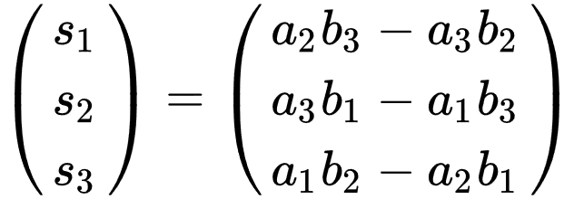

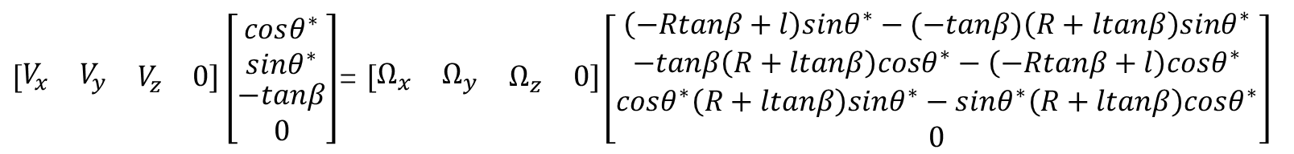
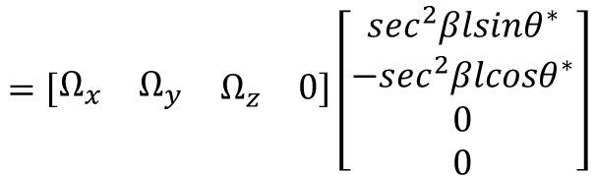

$$\left[\begin{matrix}\begin{matrix}{\overset{⃑}{X}}_{L} & {\overset{⃑}{Y}}_{L}\end{matrix} & \begin{matrix}{\overset{⃑}{Z}}_{L} & 0\end{matrix}\end{matrix}\right] \left[\begin{matrix}\begin{matrix}Ω_{x} & Ω_{y}\end{matrix} & \begin{matrix}Ω_{z} & 0\end{matrix}\end{matrix}\right]\left(\left[\begin{matrix}\begin{matrix}{\overset{⃑}{X}}_{L} & {\overset{⃑}{Y}}_{L}\end{matrix} & \begin{matrix}{\overset{⃑}{Z}}_{L} & 0\end{matrix}\end{matrix}\right]{\overset{⃑}{N}}_{ctr}(s)\right)×\left({M_{ctr}(s)}^{T}{\left[\begin{matrix}\begin{matrix}{\overset{⃑}{X}}_{L} & {\overset{⃑}{Y}}_{L}\end{matrix} & \begin{matrix}{\overset{⃑}{Z}}_{L} & 0\end{matrix}\end{matrix}\right]}^{T}\right)$$
$=\left[\begin{matrix}\begin{matrix}{\overset{⃑}{X}}_{L} & {\overset{⃑}{Y}}_{L}\end{matrix} & \begin{matrix}{\overset{⃑}{Z}}_{L} & 0\end{matrix}\end{matrix}\right] \left[\begin{matrix}\begin{matrix}Ω_{x} & Ω_{y}\end{matrix} & \begin{matrix}Ω_{z} & 0\end{matrix}\end{matrix}\right]$ ${\left({\overset{⃑}{N}}_{ctr}\left(s\right)×M_{ctr}(s)\right)}^{T}{\left[\begin{matrix}\begin{matrix}{\overset{⃑}{X}}_{L} & {\overset{⃑}{Y}}_{L}\end{matrix} & \begin{matrix}{\overset{⃑}{Z}}_{L} & 0\end{matrix}\end{matrix}\right]}^{T}$
$=$ $\left[\begin{matrix}\begin{matrix}Ω_{x} & Ω_{y}\end{matrix} & \begin{matrix}Ω_{z} & 0\end{matrix}\end{matrix}\right]$ $\left({\overset{⃑}{N}}_{ctr}\left(s\right)×M_{ctr}(s)\right)$
${\left[\begin{matrix}\begin{matrix}V_{x} & V_{y}\end{matrix} & \begin{matrix}V_{z} & 0\end{matrix}\end{matrix}\right]}^{T}$ ${\overset{⃑}{N}}_{ctr}\left(s\right)$= $\left[\begin{matrix}\begin{matrix}Ω_{x} & Ω_{y}\end{matrix} & \begin{matrix}Ω_{z} & 0\end{matrix}\end{matrix}\right]$ $\left({\overset{⃑}{N}}_{ctr}\left(s\right)×M_{ctr}(s)\right)$
$\left[\begin{matrix}\begin{matrix}V_{x} & V_{y}\end{matrix} & \begin{matrix}V_{z} & 0\end{matrix}\end{matrix}\right]\left[\begin{matrix}\begin{matrix}cosθ^{∗} \\ sinθ^{∗}\end{matrix} \\ \begin{matrix}−tanβ \\ 0\end{matrix}\end{matrix}\right]$= $\left[\begin{matrix}\begin{matrix}Ω_{x} & Ω_{y}\end{matrix} & \begin{matrix}Ω_{z} & 0\end{matrix}\end{matrix}\right]\left[\begin{matrix}\begin{matrix}\left(−Rtanβ+l\right)sinθ^{∗}−(−tanβ)\left(R+ltanβ\right)sinθ^{∗} \\ −tanβ\left(R+ltanβ\right)cosθ^{∗}−\left(−Rtanβ+l\right)cosθ^{∗}\end{matrix} \\ \begin{matrix}cosθ^{∗}\left(R+ltanβ\right)sinθ^{∗}−sinθ^{∗}\left(R+ltanβ\right)cosθ^{∗} \\ 0\end{matrix}\end{matrix}\right]$
$$=\left[\begin{matrix}\begin{matrix}Ω_{x} & Ω_{y}\end{matrix} & \begin{matrix}Ω_{z} & 0\end{matrix}\end{matrix}\right]\left[\begin{matrix}\begin{matrix}{\sec^{2}βlsinθ}^{∗} \\ −\sec^{2}βlcosθ^{∗}\end{matrix} \\ \begin{matrix}0 \\ 0\end{matrix}\end{matrix}\right]$$
$V_{x}cosθ^{∗}+V_{y}sinθ^{∗}−V_{z}tanβ=Ω_{x}$ ${\sec^{2}βlsinθ}^{∗}−Ω_{y}\sec^{2}βlcosθ^{∗}$
$\left(V_{x}\text{+} Ω_{y}l\sec^{2}β\right)$ $cosθ^{∗}+\left(V_{y}−Ω_{x}\sec^{2}βl\right)sinθ^{∗}=V_{z}tanβ$
$$M_{ctr}\left(s\right)=\left[\begin{matrix}\begin{matrix}\left(R+ltanβ\right)cosθ \\ \left(R+ltanβ\right)sinθ\end{matrix} \\ \begin{matrix}−Rtanβ+l \\ 1\end{matrix}\end{matrix}\right]$$

